Slide 1

Group 7
Made by Adrian, Daniel and Tobias

Slide 2
Problem introducion
Theme: Flight price aggregator
Unified interface
Frontend and backend
Notes:
For this project, we were assigned the theme of building a Flight Price Aggregator, under the brand name Flight Finder. The primary objective was to develop a functional and user-friendly platform that enables users to efficiently compare flight prices from multiple providers.
The core problem we addressed is the fragmented nature of online flight booking our platform streamlines this to a single site.
This process is inefficient and can lead to inconsistent or unclear pricing data.
Our platform aims to solve this by aggregating flight data from various sources and presenting it in a unified, structured, and accessible interface. The goal was not to process bookings directly, but to serve as a neutral intermediary that streamlines the discovery and comparison of flights.
From a technical perspective, this problem provided the opportunity to integrate a complete front-end and back-end solution, implementing key requirements such as user authentication, role-based access, responsive design, RESTful APIs, and dynamic data loading.

Slide 3
Work methodology
Agile development
2 week sprints
Physical meeting
Roles
1 Repository
Notes:
To manage our project efficiently, we followed an agile development process using bi-weekly parallel sprints—one for the frontend and one for the backend.
In every sprint, roles were assigned—like Sprint Master and Stenographer. Tasks were broken down into user stories with story points, and assigned individually.
We used version control with Git, and worked in 1 repository for the frontend and backend.
Our sprint meetings was physical and we held verbal retrospectives where we wrote down individually what could be improved.
Throughout the sprints, we held regular stand-ups and adjusted our backlog as needed.
For example, in Sprint 9, although we planned more than we could complete, we ended up achieving more functionality than in previous sprints.
We documented our progress in detailed sprint reports and used retrospectives to reflect on performance and improve collaboration.

Slide 4
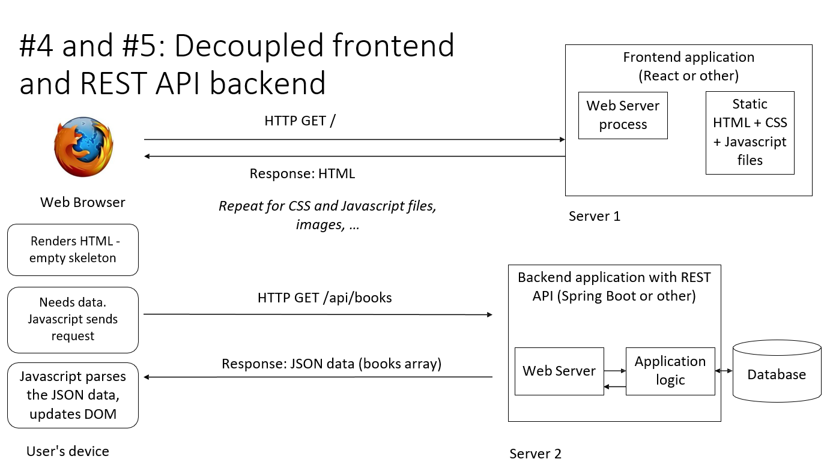
Architecture
Decoupled
NTNU server
Authentication (JWT)
Mysql
Notes:
ADRIAN
We have gone for a Decoupled Application architecture. Our frontend is created with react and runs on a server provided by NTNU, whilst our backend is written with spring boot runs on this same server provided by NTNU for this project.
For authentication we use JWT and the database we use is a mysql database running on the server provided by NTNU.

Slide 5
Design decisions and agreements
Roundtrips
Default flights
Notes:
Adrian
For searching we made the decision to not handle the user buying roundtrips or trips with multiple layovers. We discussed this with the customer and decided that it would be best to just let the user buy the tickets themselves if the want a trip to and back from a destination, since we are a flight aggregator service.
We don’t necessarily have the default flights listed in the project description, instead we automatically generate our own flights with a dummy data generator.
## We used an api together with the users IP to automatcially set the currency of the country in which the user is accessing the site from. Using this all our products prices are automaticallly converted to this currency.

Slide 6
Design
Professional theme
Shades of blue
WCAG 2.0,Uutilsynset and Yale
Notes:
SHOW DESIGN GUIDELINE
For our design, we followed a serious and professional theme to build user trust, which is crucial when dealing with flight bookings and large payments. Our color scheme centered around shades of blue to evoke calmness and reliability, with a strong contrast using an orange call-to-action color.
We built our design guideline using principles from WCAG 2.0, UUtilsynet, Yale’s usability checklist, and Don Normans principles. Most of the defined design elements—like the color palette, layout hierarchy, responsive breakpoints, and semantic HTML—have been consistently followed in the final implementation.
We used clear typography, accessible contrast ratios, and responsive layouts for desktop, and mobile. Accessibility features like keyboard navigation, semantic tags, and alt text were also implemented across the site.

Slide 7
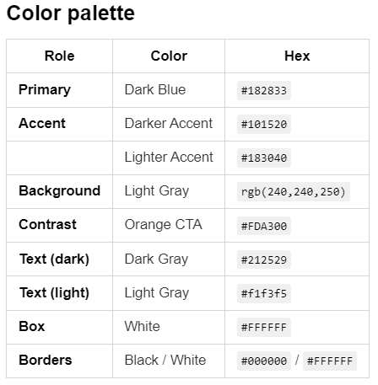
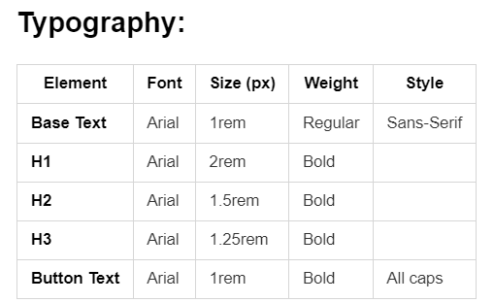

Slide 8
Don Normann
Visibility
Feedback
Constraints
Mapping
Consistency
Affordance
Notes:
We also applied Don Norman’s six usability principles to make our website more accessible and intuitive:
Visibility: Important elements like the search bar and call-to-action buttons are clearly visible and placed at the top of the page for immediate access.
Feedback: Users get real-time visual feedback—for example, a highlight or confirmation when adding a flight to favorites or the cart.
Constraints: We limit what users can do based on their role. For example, visitors can’t purchase without logging in, which prevents confusion.
Mapping: Buttons and icons are placed where users expect them, like filters on the left and actions next to products, following standard web patterns.
Consistency: We’ve used consistent colors, fonts, and component styling throughout the site to make navigation predictable.
Affordance: Interactive elements like buttons and inputs are styled clearly to show they are clickable or editable, improving usability for all users.

Slide 9
IDATA-2301

Slide 10
Wireframes
Individual wireframes
Combined into 1
Adjustments
Notes:
In the early phase, all three of us created our own wireframes—some were hand-drawn, others built directly with HTML and CSS. These reflected our individual ideas for layout, structure, and user flow.
We then met and combined the best parts of each version into a single, unified wireframe that included everyone's input.
While the final product does follow the main structure, it has strayed slightly from the original plan due to design adjustments and feature changes made later in development.
You will see that in the showcase of the final product. But first, here is the final wireframe.

Slide 11
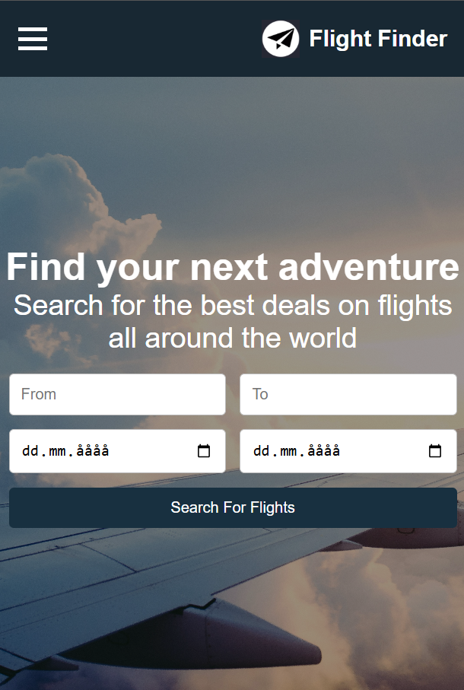
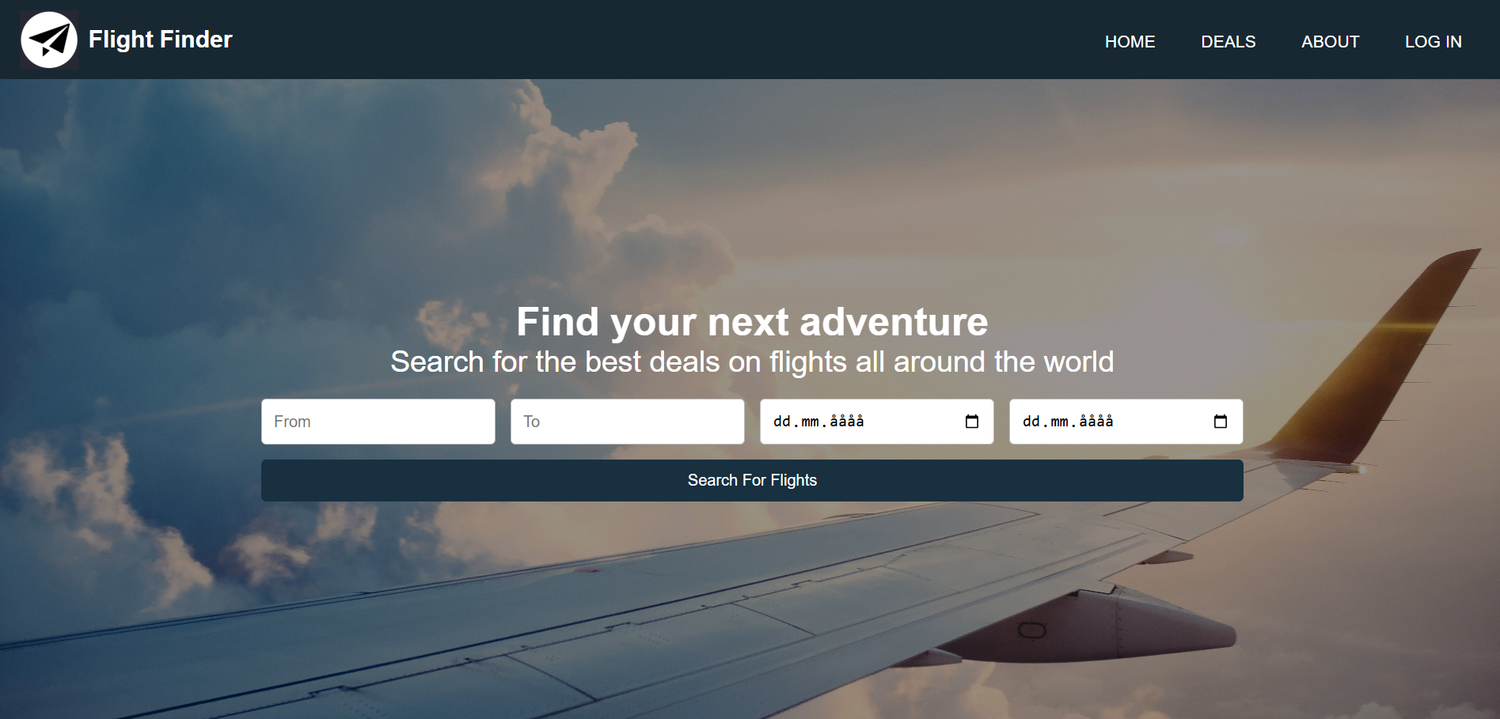
Front page

Slide 12
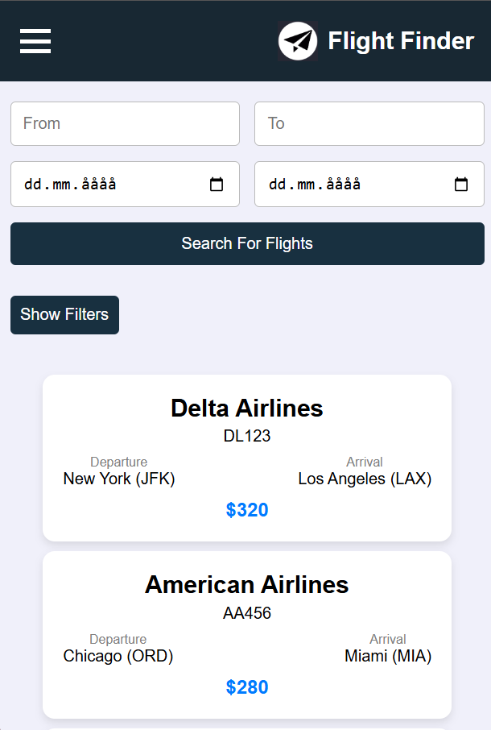
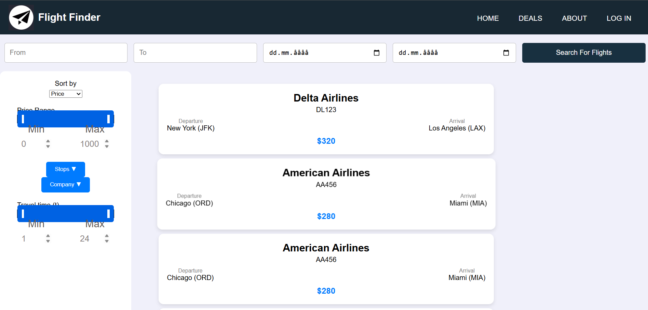
Deals page

Slide 13
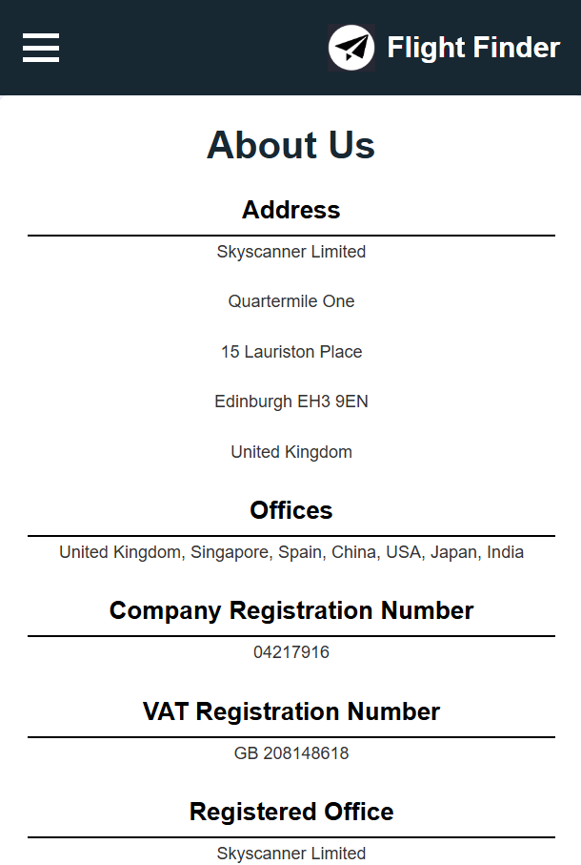
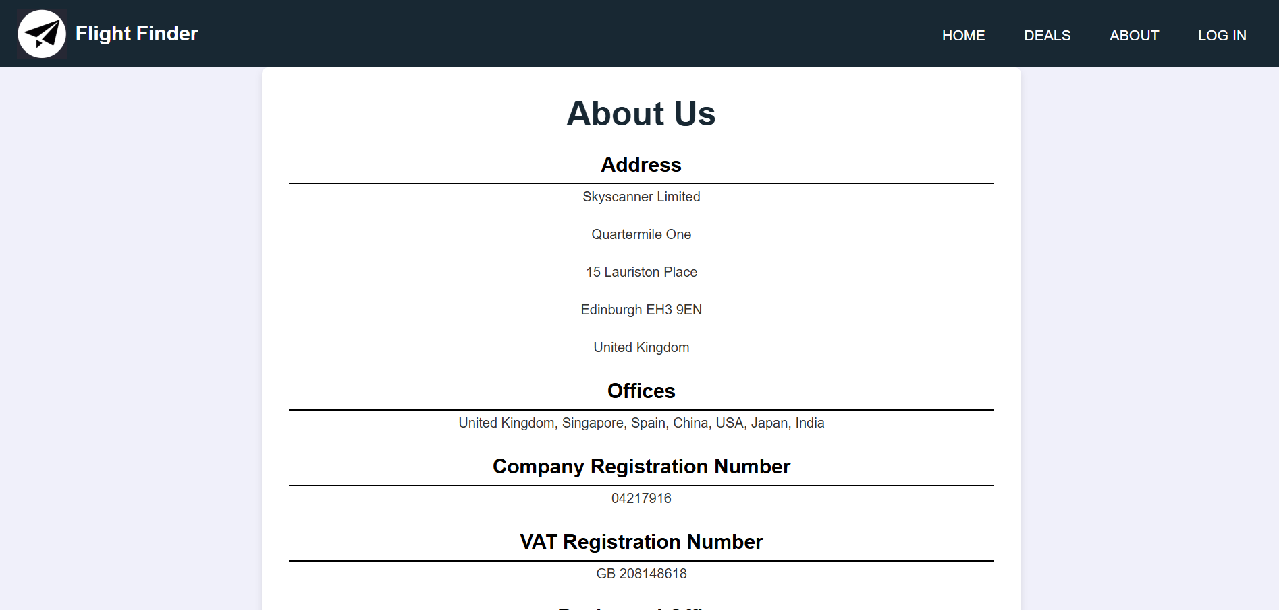
About page

Slide 14
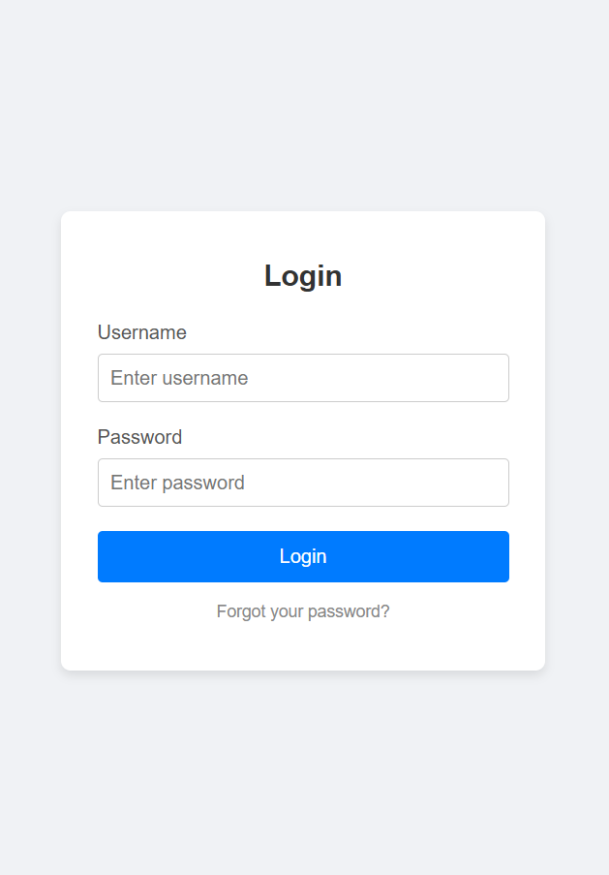
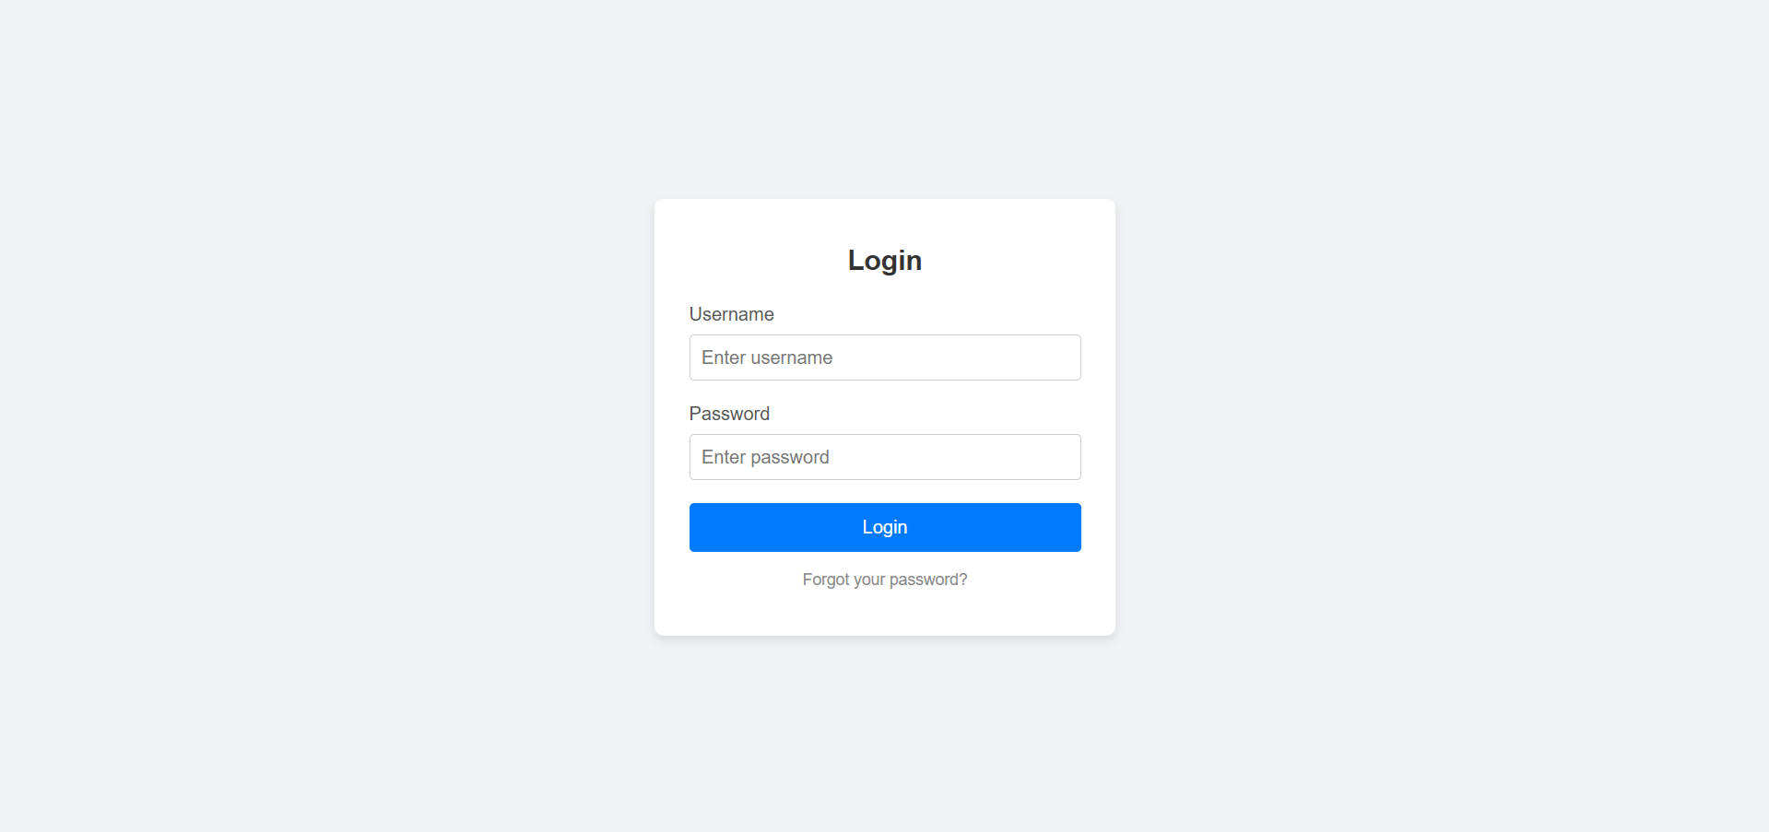
Login page

Slide 15
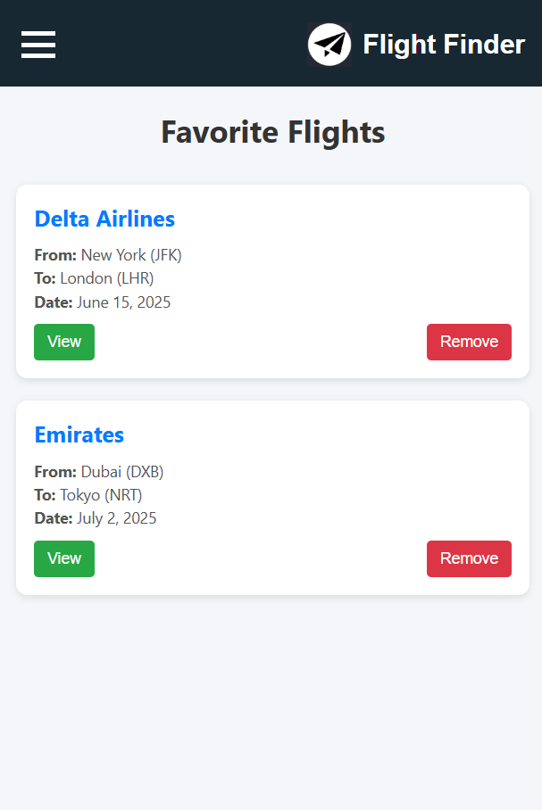
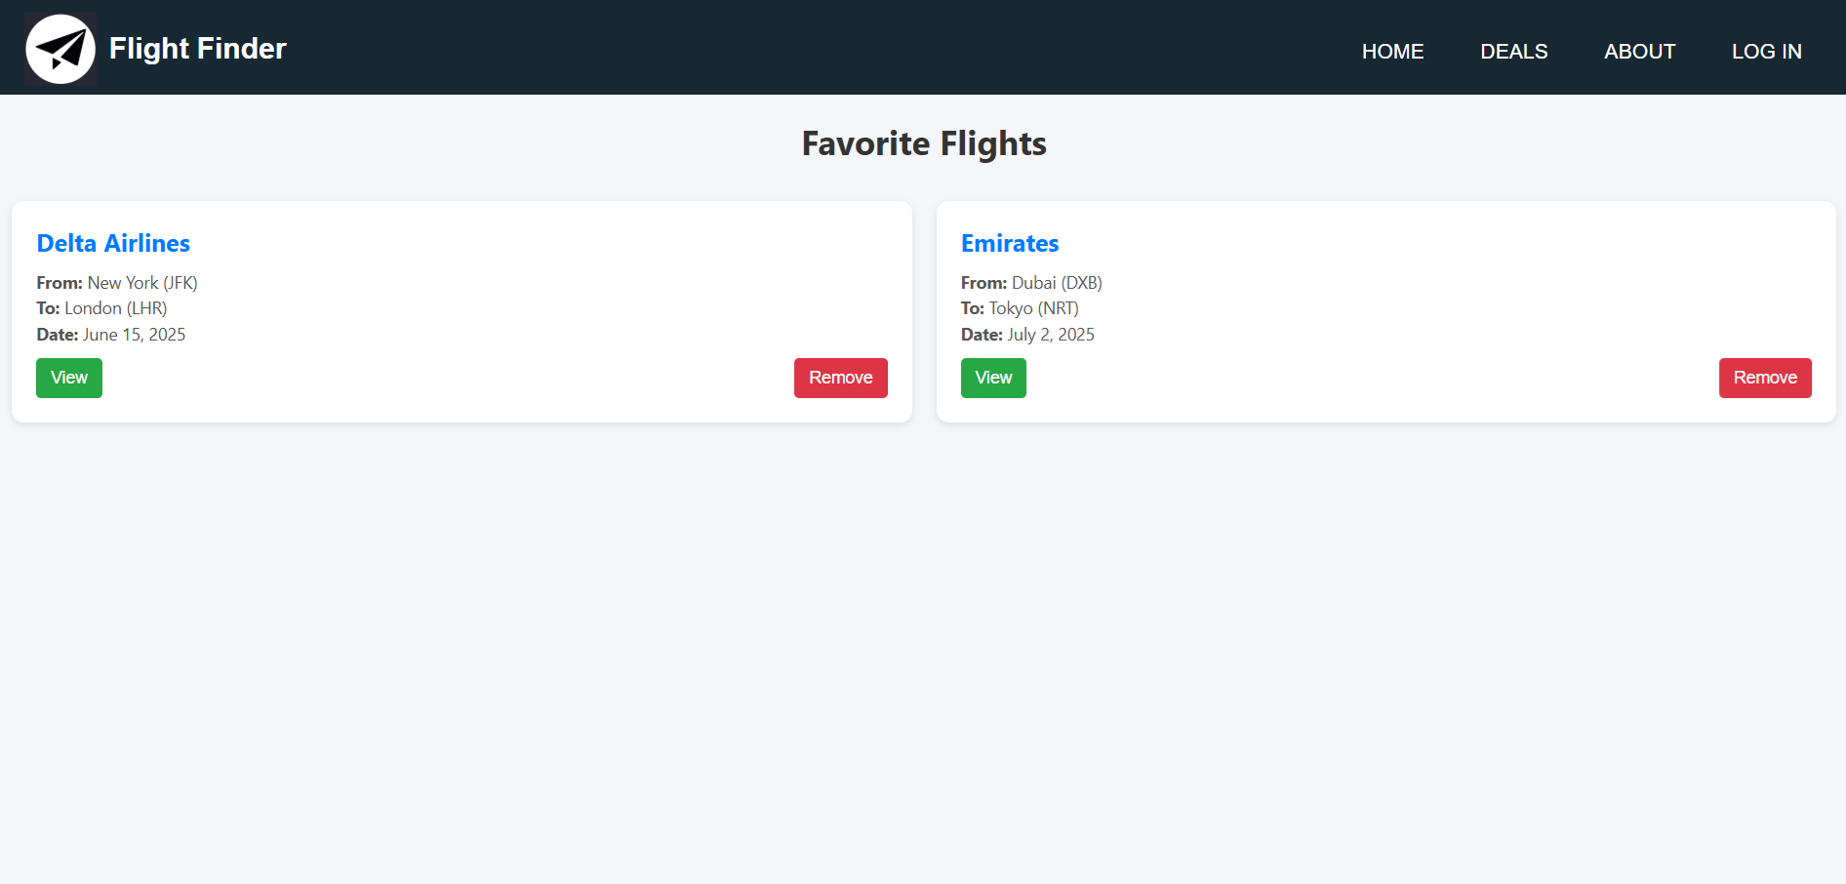
FavorItes page

Slide 16
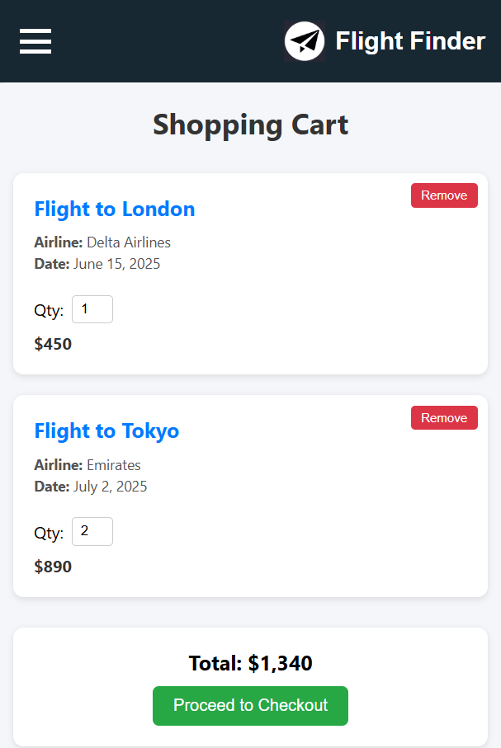
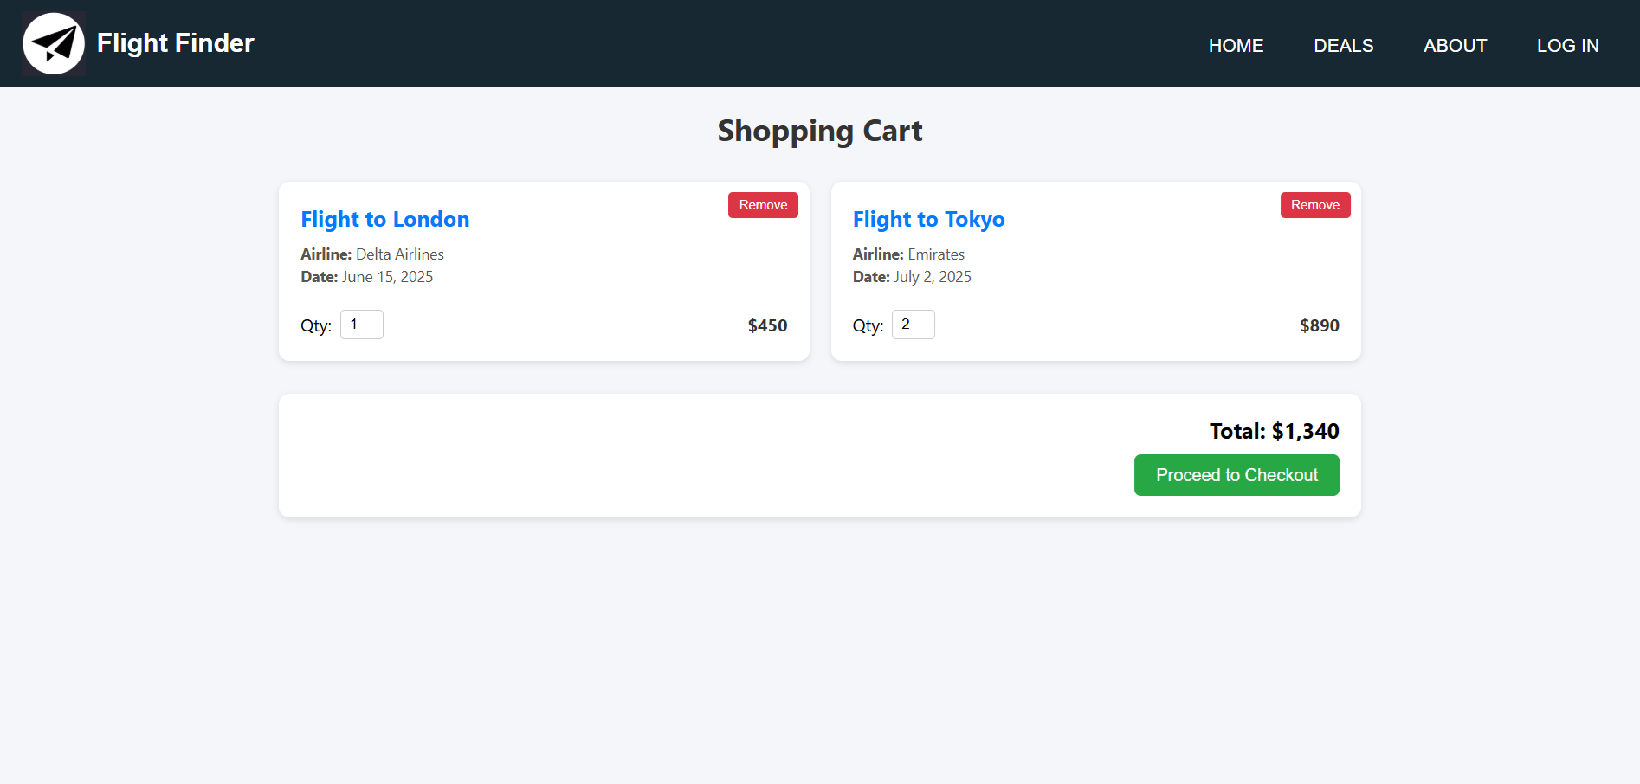
Shopping cart

Slide 17
Demo of the functionality
Video showcase
Notes:
TOBIAS

Slide 18
Responsiveness
Video showcase
Notes:
ADRIAN

Slide 19
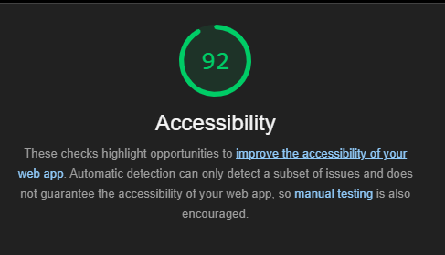
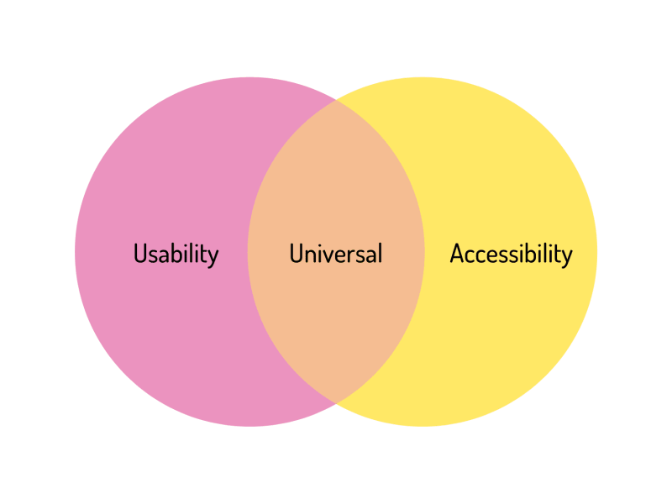
Accessibility and usability
Followed guidelines
Semantic HTML5 tags
Alt text for images
Color contrasts
Fully responsive
Notes:
Accessibility and usability were important priorities in our project. We followed the WCAG 2.0 guidelines as well as recommendations from UUtilsynet and Yale's usability checklist to ensure that the site is inclusive and user-friendly.
We used semantic HTML5 elements like <header>, <main>, and <button>, which makes the structure clearer for both screen readers and keyboard users. Every interactive element is navigable via keyboard, with visible focus indicators and logical tab order.
All images include alt text, and what’s unique is that the alt text is automatically updated based on the content—for example, a flight from KLM will display alt text describing the KLM airline and destination, making it easier for screen reader users to understand the context.
We also ensured color contrast meets accessibility standards and verified it using contrast checkers.
Our layout is fully responsive across mobile, and desktop, and we've tested accessibility using Lighthouse and the W3 validator.

Slide 20
Extras
Filtering
Sorting
Automatic currency convertion
Recommended cards
Deleting users
Adding/deleting roles for users
Notes:
Adrian
After the user has searched for a flight, they are able to both filter and sort their results using multiple different metrics.
They can sort the result by the price of the flight in ascending and descending order, and they can sort by the departure date, also in ascending and descending order
If the user is looking for a flight in a certain price range, they can use our price filtering slider to only show results in a certain price range. And if they want to fly with a specific company, or don’t want to, they can filter which companies appear for the search results.
The price range is limited to be in the range of the least expensive to the most expensive flight, for a better user experience. And the company filtering only shows the companies which provide the searched for flights.
We used an api together with the users IP to automatcially set the currency of the country in which the user is accessing the site from. Using this all our products prices are automaticallly converted to this currency.
If the user scrolls down in the home page, they can explore multiple of our popular flights. For example our most popular flight, one of our recommendations, the cheapest flight and more. The user is able to click on these recommended cards and are then taken to that flights details page.
The admin is able to delete users and users are able to delete their own account.
Finally the admin can add/delete roles for users.

Slide 21

Reflection
Notes:
What have you learned in the course?
We have learned how to communicate with backend with the help of API endpoints.
We have learned about accessability, usability and best practises.
We have also learned about React, html, css and javascript.
We learned about Node.js
We have learned about different application architectures, the pros and cons of them.

Slide 22
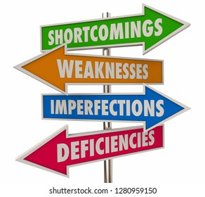
Routing
Lack of routing
Seemed faster
Wanted to switch
Notes:
One of the key shortcomings in our project was the lack of proper client-side routing. Instead of using a routing library like React Router, we managed page transitions through internal state changes.
Initially, this approach seemed faster for development, but as the project grew, it became harder to manage and maintain.
We did consider switching to routing later in the project, but by that point, it would have required major refactoring of our component logic and state handling—especially for conditional rendering and user roles.
This was a valuable learning experience. In future projects, we would implement routing from the start to support a cleaner structure, better browser navigation, and improved scalability.

Slide 23
IDATA-2306

Slide 24
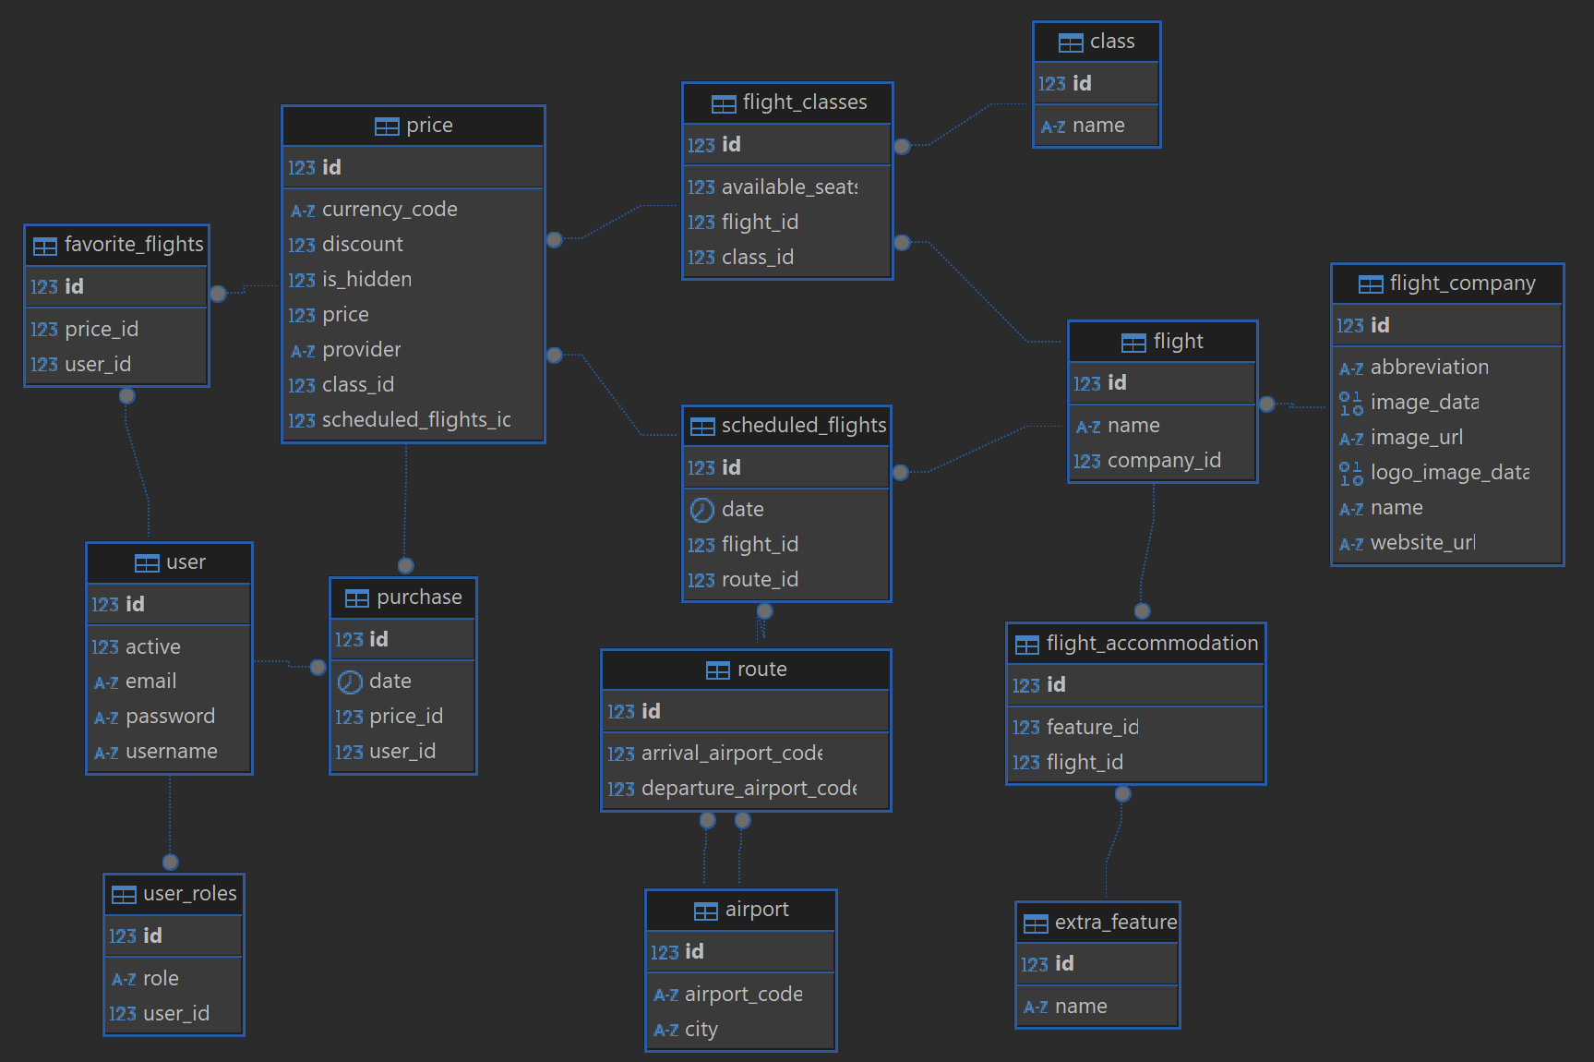
Database schema
14 tables
Notes:
ADRIAN
To fulfill all the requirements in a good manner following best pracices, we ended up with 14 different tables.
We have for example a user table which is referenced by the user_roles table to assign a user multiple roles, for example admin, support etc. The user id is also used to store a users purchases and favorite flights.
A product, which we have called price references the scheduled_flights table, which stores which flight is taking a certain route at a certain date. The price table also stores the currency code, for example NOK or USD, a discound, if it is hidden by the admin, the price, who the provider is, and has a class_id which references the flight_classes table which has information about how many seats a certain flight has and what flight clas that is, for example economy class or business class.
Furthermore the flight table has the name of the flight and a reference to the flight_company table, which has information about the company who have that flight. Like their logo, their name, an url to their website and so on.
Each flight may have some extra features like wifi or extra legroom. This is stored using the flight_accommodation table which facilitates a many-to-many relationship between a flight and its extra features.

Slide 25
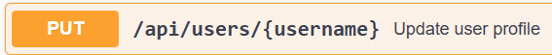
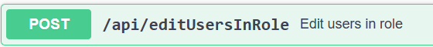
API endpoint documentation
Swagger documentation
Notes:
Swagger

Slide 26
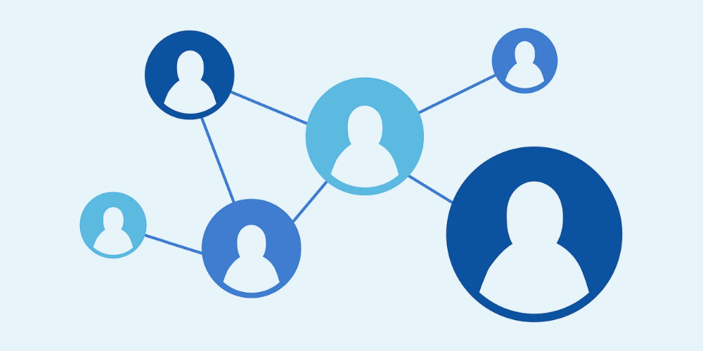
User roles
Visitor
User
Admin
Notes:
Our website is built around a clear role-based access system with three user roles: visitor, user, and admin—each with progressively more access and functionality.
A visitor is anyone not logged in. They can browse flights, view flight details, and even add items to the shopping cart. However, to actually purchase flights, favorite them, or access a profile page, users must be logged in.
Once logged in as a user, you gain access to all standard features, including viewing your purchase history, managing favorites, and adjusting profile settings like preferred currency.
Finally, admins have full control. They can manage the visibility of flights—for example, hiding specific listings.
Admin can add and delete roles for users. And each user can have many roles.
This role-based system ensures that access is both secure and structured, depending on the user’s level of authorization.

Slide 27
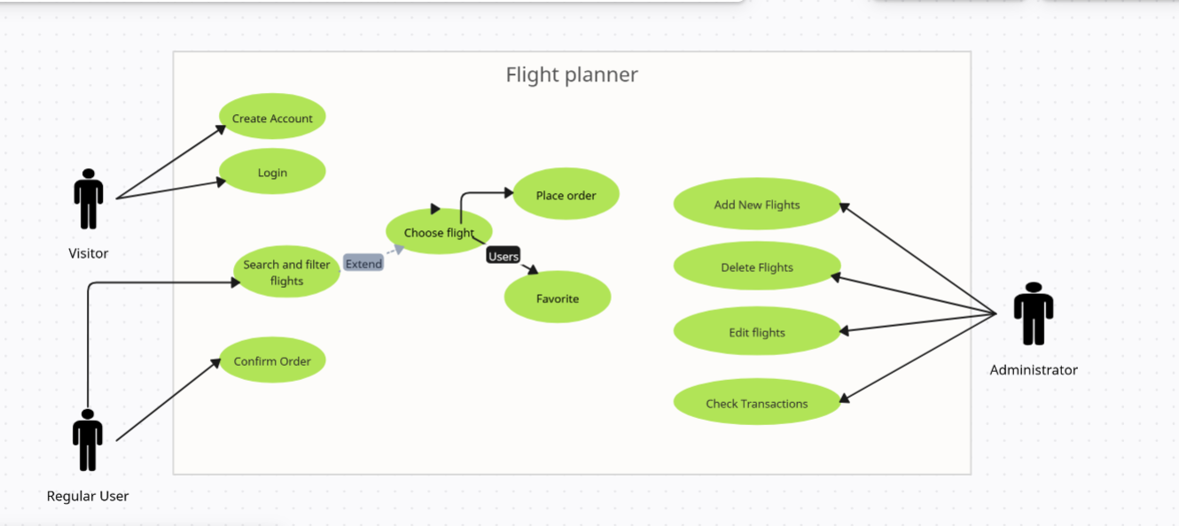

Slide 28
Demo of the functionality
Video showcase
Notes:
When the user opens the web site. They are presented with a clear hero section with a call to action, the search bar. At the bottom of the page the user is prompted for if the want to accept cookies. Doing so will lead to a better user experience since they are used, among other things, for automatically determining the preferred currency of the user.

Slide 29
Tests
Postman

Slide 30
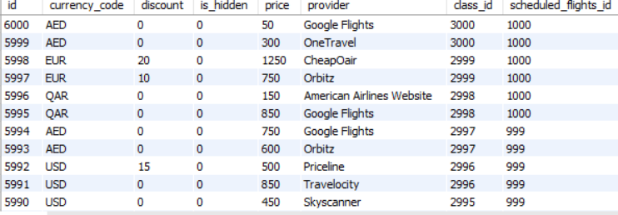
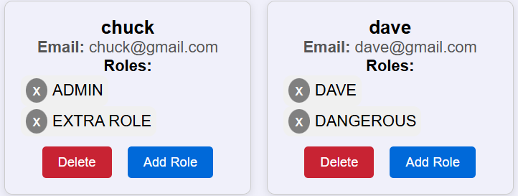
Extras
Dummy data
Admin can create roles and assign them

Slide 31

Reflection
Notes:
We have learned about jwt authorization.
We have learned how to create and use endpoints
How to create swagger doc for controllers
Learned how to create a backend with spring-boot
How to deploy programs and such on a server.
Put into practice what we learned previously about databases at school.
Learned how to do object relationship mapping with jpa
Utilizing environment variables

Slide 32

Problems with https
Notes:
We had issues with establishing a HTTPS connection for our application, we believe this was due to issues with the IP address our domain used. The issue resulted in certbot not being able to create a certificate for us which made use opt out of establishing a HTTPS connectoin. Instead we just run the frontend and backend on our server and all communication between web browser and frontend/backend happens over HTTP.

